Slide 1
OUTREACH
COMMUNICATION
MULTI MEDIA

Slide 2
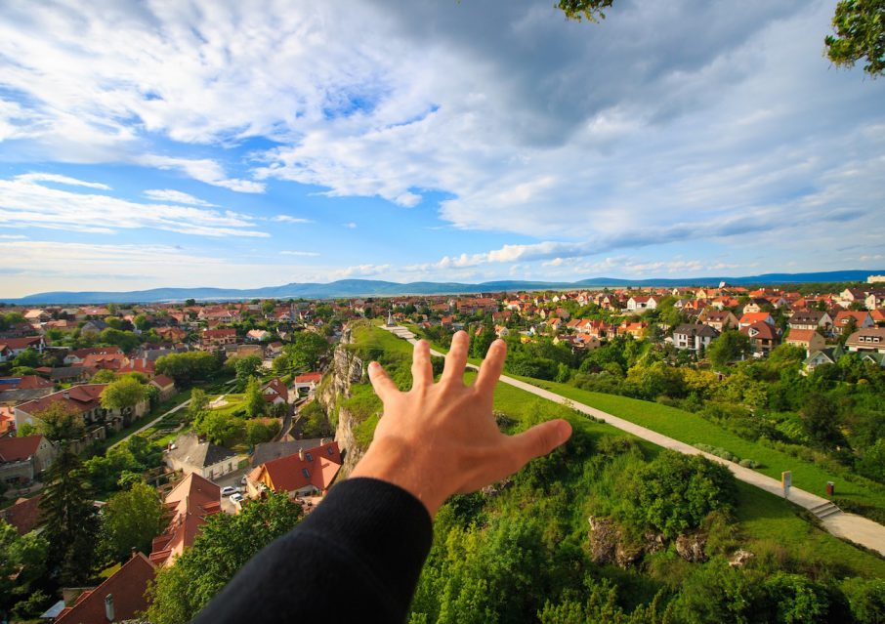
OUT
R E A C H
What does it mean?
“…effort by individuals in an organization or group to connect its ideas or practices to the efforts of other organizations, groups, specific audiences or the general public.” Google
Why does AMA encourage Outreach?
Connect new modelers to clubs and members.
Connect clubs to the AMA Community through district and national initiatives and activities.
Connect AMA to the General Public outside our aeromodelling community.
How do we best “REACH OUT TO OUTREACH” ?

Slide 3
Getting to know our Clubs & Members better…
Their:
Interests & Activities
Member Skill Sets
Volunteer and Advocacy Desires
Their Limitations or Restrictions
*Sharing accurate, honest, and current information with AMA and the Community allows us to identify members interested in outreach activities and where to send new prospective members to find the “best fit”.
*Accurately reporting also allows AMA to preserve the privacy of those members who choose to keep their hobby private. Outreach is not for everyone.

Slide 4
ESTABLISH COMMUNICATION
Club “Contacts”-
The club’s Public Relations person
Club Disseminator - sharing Club, District, Hobby, and AMA news to the officers and members utilizing email, phone, and social media.
Club contacts can be officers or an appointed role. Often a good secretary or newsletter editor also makes a good club contact.
Club Officers- Some qualities to look for in an effective club contact:
fluent in email, website browsing/ use, social media skills, loves the hobby, supports the club and AMA.
If no volunteers step up for this crucial role? Presidents- that’s on YOU!
If this is your “club contact’s” reaction to email, the internet and social media, they may not be the best one for the job!

Slide 5
A few things to consider: *Disclaimer- This is for clarity and NOT to judge any particular club or member! When AMA attempts to match a member to a club we LOOK FOR THE BEST FIT.
The better we know your club (the “product”) the better we can suggest (“sell it”) to a prospective member.
“Open Club”
Suggests “OPEN” to ALL prospective new members.
Open to All disciplines of aeromodelling
Open to All types of activities
A Fully engaged club (to the level clubs are capable)
“Restricted or Limited Club”
For any number of reasons the club may limit or restrict certain disciplines, activities or membership.
You may have a landowner, landlord, or controlling agency with restrictions or other valid reasons.
Defining and accurately listing such restrictions on club charter renewals allows AMA to better match new members with the “best fit” club for their needs.
Capped Membership
For any number of reasons the club may decide to set a maximum number of members or establish a waiting list.
Similar to “restricted” clubs above, it could be operational, land owner controlled, or other valid reasons.
Clubs should consider the TOTAL members : Active members (those using the flying site on a regular basis)
when considering to Cap membership.

Slide 6
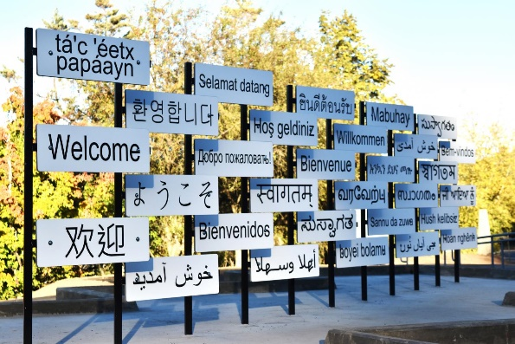
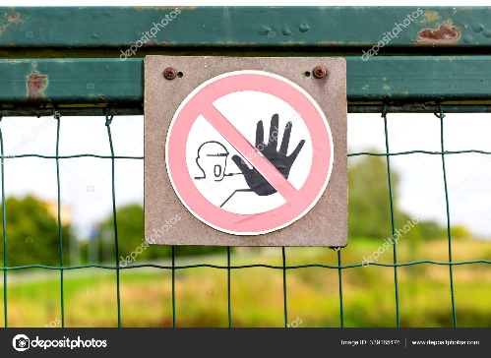
No matter how our clubs are set up; Open, Restricted, Limited or Capped.
Please, ALWAYS BE WELCOMING to anyone who visits. We are ALL the face of our clubs, AMA and our hobby community.
Mom always says- “If you can’t say something nice...!”
This…or...This?
Think about it/ Discuss
CBO, FRIA!

Slide 7
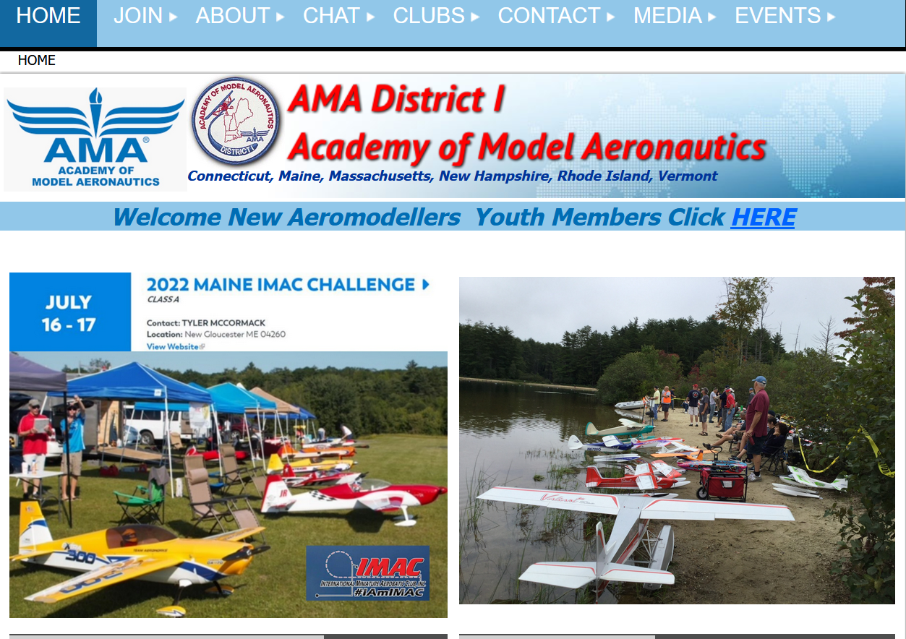
BE CONNECTED TO THE COMMUNITY
CLICK- On www.amadistrict-i.org
BROWSE- The many features and links
JOIN- To allow full access to the site- it’s free!
BOOKMARK- Go To Home Page!
SHARE- Club websites, FB Groups, Newsletters…
YOUR Website, YOUR FB Group, YOUR YouTube Channel, AMA multi media platforms, popular modeling groups and much much more one click away.
Let’s take a short tour
www.amadistrict-i.org

Slide 8
Understanding OUTREACH
Knowing CLUBS & MEMBERS Better
COMMUNICATING Using
MULTI MEDIA TO SHARE OUR EXPERIENCES…
OUR COMMUNITY CAN MORE EFFECTIVELY
PRESERVE, PROTECT AND PROMOTE OUR
PASSION, OUR HOBBY

Slide 9
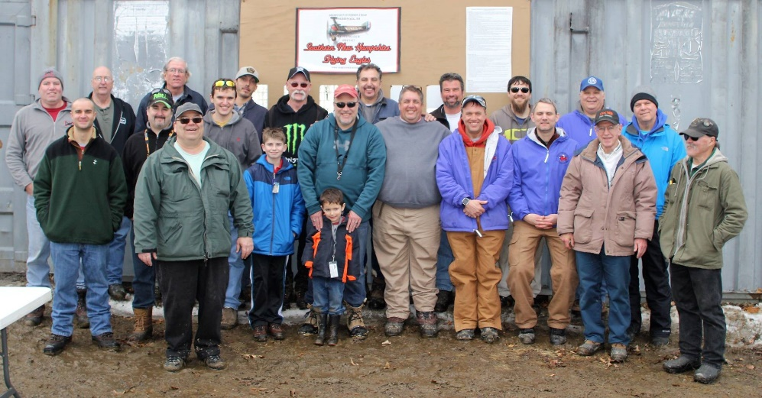
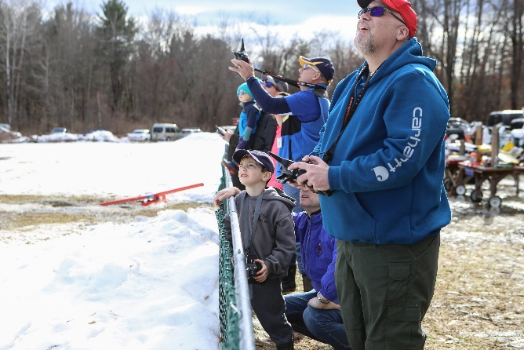
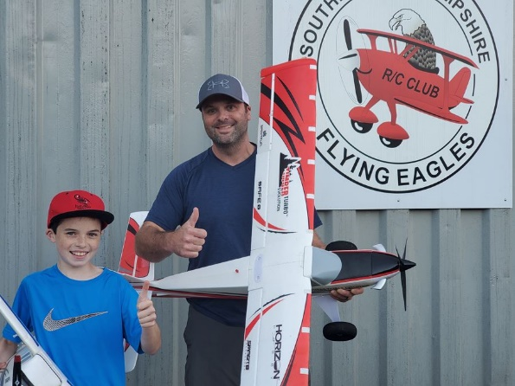
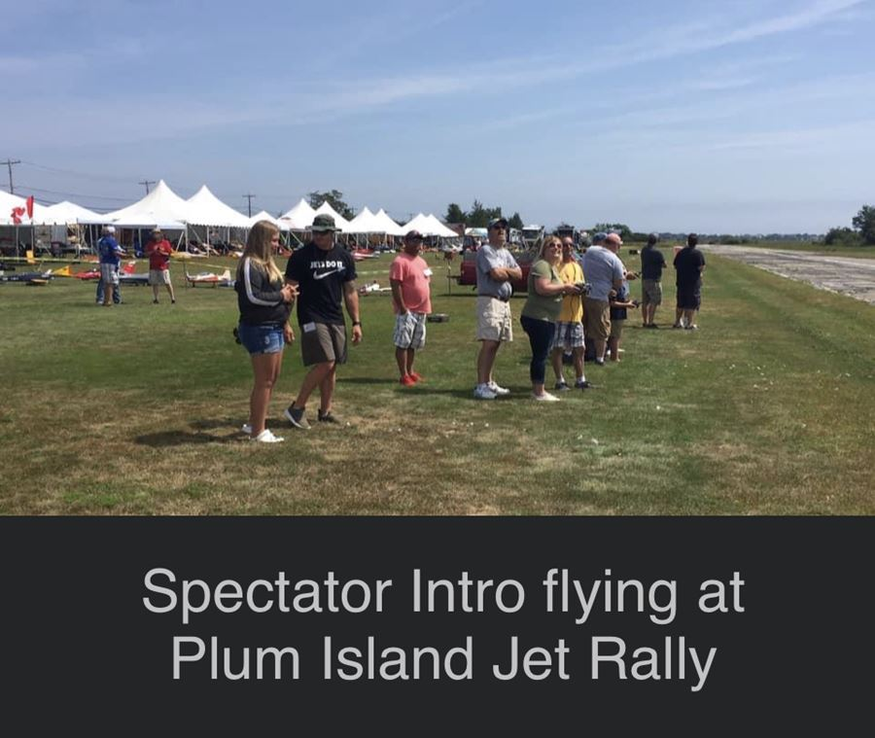
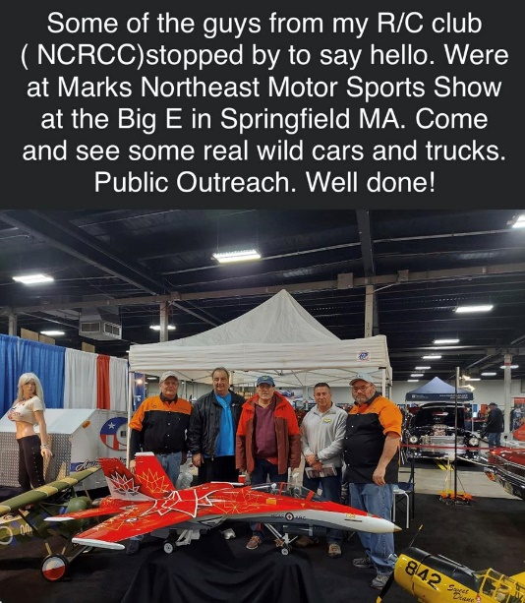
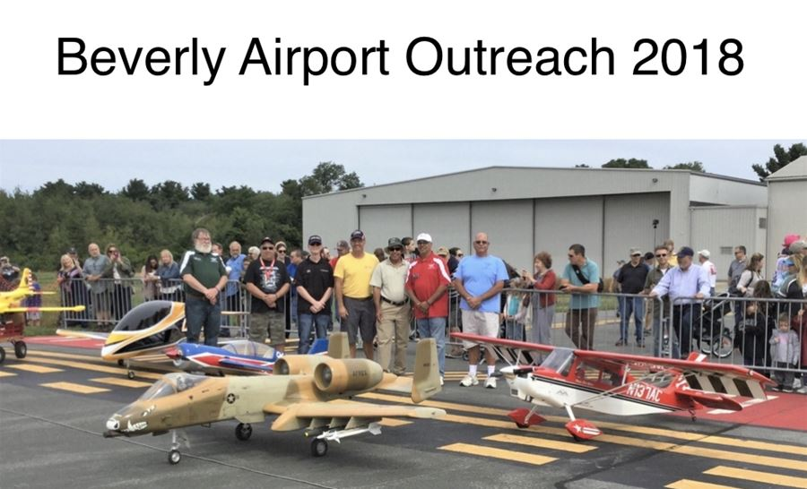
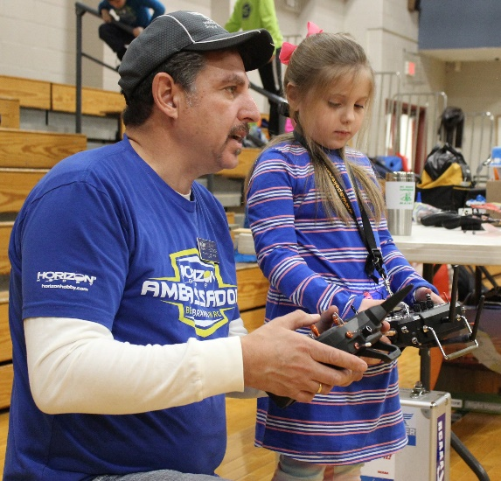
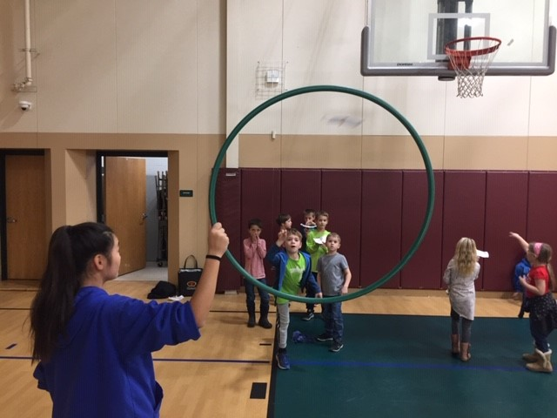
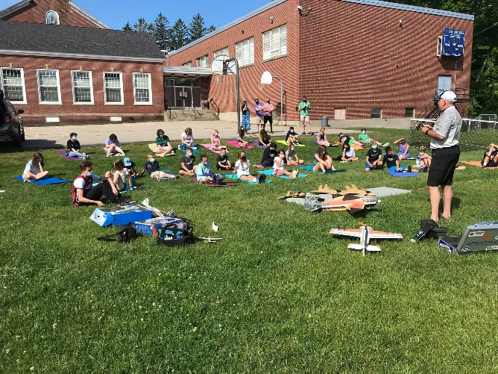
CLUBS –
Where it all starts!
PUBLIC OUTREACH
EDUCATION OUTREACH

Slide 10
Let’s Talk about it!
Find this recording, District Zoom meetings, events and more at
YOUR District 1 YouTube Channel through our district 1 website.
Thank You for watching.
Fly often, fly safely Reach out to OUTREACH!
Most aeromodelling resources are one click away at: www.amadistrict-i.org

