Slide 1
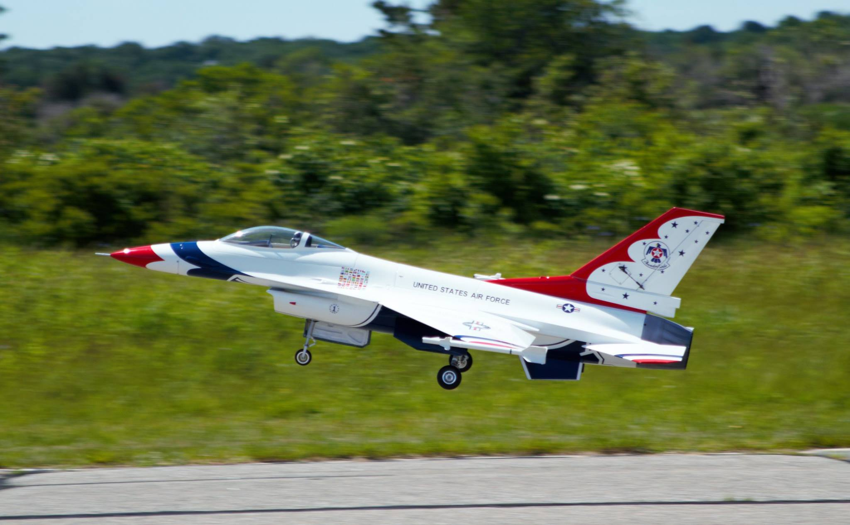
How do Airplanes fly? How do we control them? Let’s takeoff and find out!

Slide 2
Brought to you by:
Notes:
Video thumbnail is hyperlinked to AMA Flight School page for video.

Slide 3
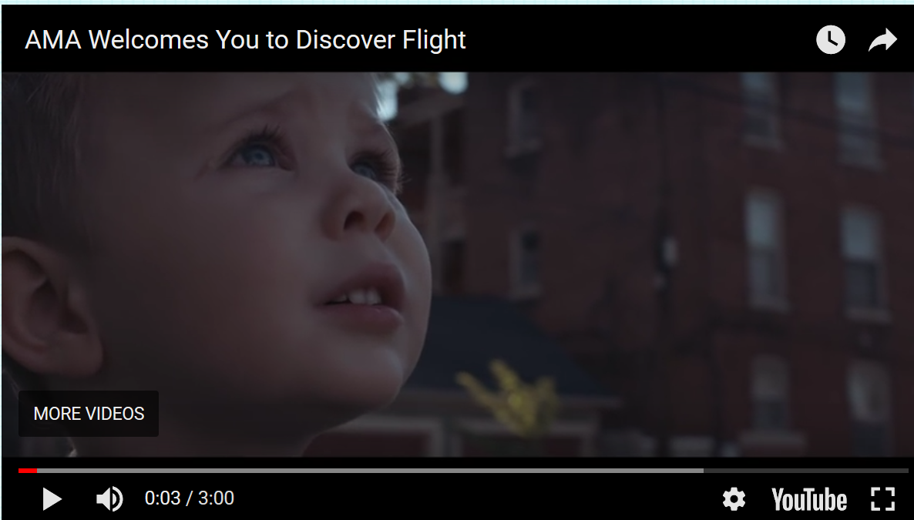
Let’s start with a short video…
Notes:
“Total Control” is hyperlinked to AMA Flight School video page.
For District 1- Mention that aircraft to left is World Aerobatic Champion and Airshow performer Rob Holland, from Maine, went to Daniel Webster College in Nashua where he began flying aerobatics and started his competition aerobatics and airshow career. Notably one of the best aerobatic pilots in the world.
Biplane to right is world famous Airshow Performer Skip Stewart who accomplishes amazing maneuvers in his custom designed and built “Prometheus” biplane.
Both these pilots are shining examples of the importance of STEM educations, dedication, innovation and inspiration.

Slide 4
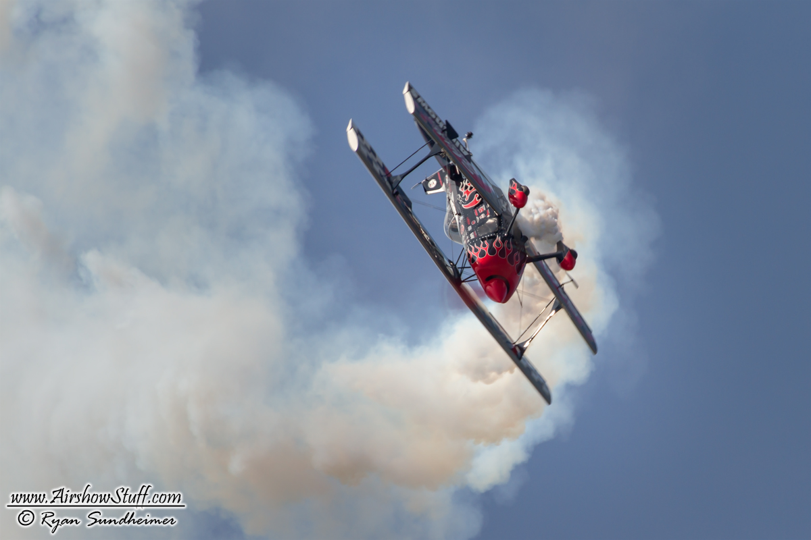
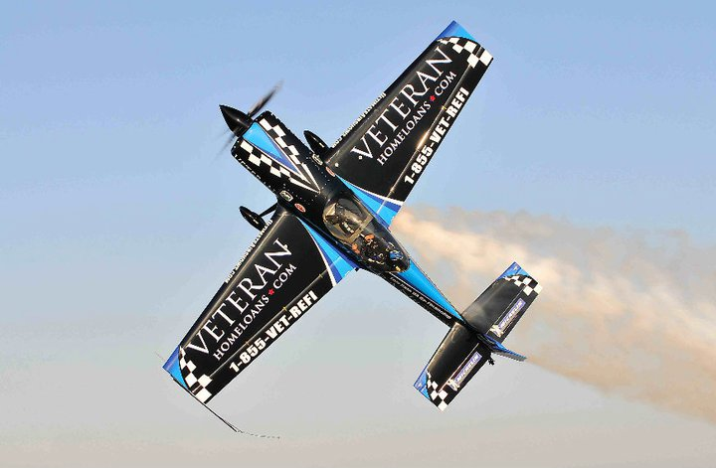
Time for another movie! Now we’ll learn about “total control” <click
Rob Holland
Skip Stewart
Notes:
As Total Control video nears end pass out supplies for build.

Slide 5
Let’s Build something that flies! But what?
What do a 9” Foam picnic plate, a penny and some tape have in common ???

Slide 6
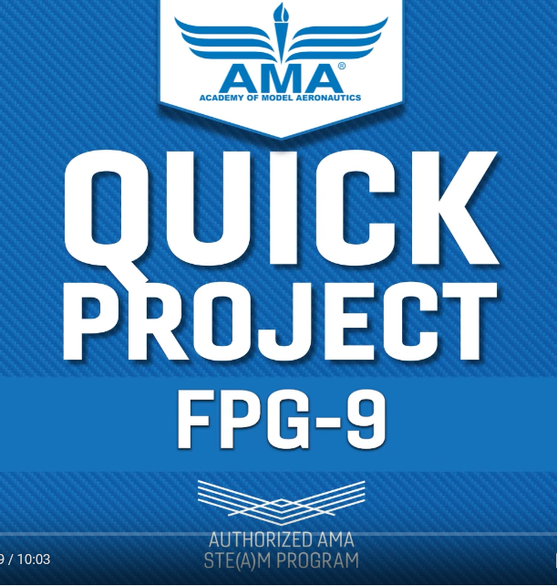
Learn how to build a “Foam Plate Glider- 9 Inch

Slide 7
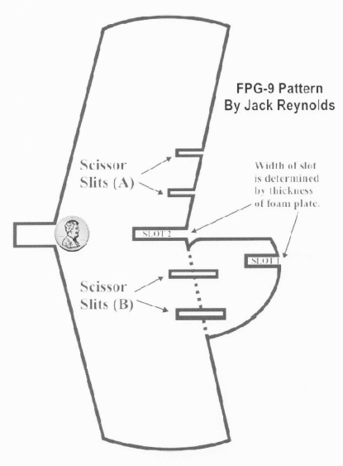
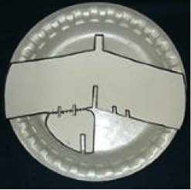
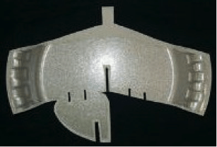
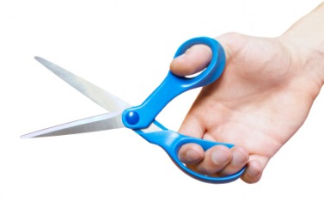
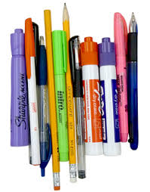
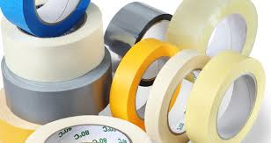
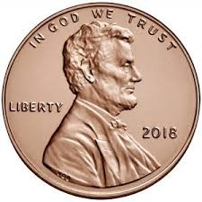
Each Team/ Builder needs supplies:
1- 9” Foam Plate and paper template or the Pre-Cut template of the FPG 9
Scissors
Pen/ Marker
Tape
1 Penny
OR
Notes:
Make sure Teams are organized with leader and tasks. Particularly Quality Assurance/ ATD- Attention To Detail “Double Checker”

Slide 8
Team tasks/ jobs If we are working in teams today make sure each team: >has a leader choose a team captain, Pick a team name >assigns tasks tracer, cutter, taper for example >performs quality assurance One or more people to double check work

Slide 9
OK, Ready? Lets start. Oh, Wait! One reminder before we start, it’s a very important thing for designers, engineers and builders to remember, especially when it comes to airplanes. Any ideas?

Slide 10
“A T D”- attention to detail which means: > follow instructions, plans and steps > double check work.
You guys have never heard that before, right?
OK, really, lets get started…
Notes:
If you are building with one of the pre cut templates provided in the FPG 9 “kits” then you can begin at step 3. Emphasize the tail cut, the “slit” cuts for the control surfaces, drawing (lightly scoring with a pen) a hinge line for each Elevon and the Rudder and that the “Slot” cuts on the wing and Tail need to be wide enough so tail sits at a right angle without binding- this is your Vertical Stabilizer and must be at a right angle to the wing to get the best performance from our FPG9.

Slide 11
Want to play a game? let’s call it a “challenge”
Let’s let the Academy of Model Aeronautics (AMA) Flight School along with Astronaut and Space Shuttle Commander Robert “Hoot” Gibson help put Newton’s Laws of Motion to work flying planes. “Hoot” will tell us about Lift, Weight, Thrust and Drag in:
The Principles of Flight<Click
I think this will help you understand more about How Planes Fly…
Notes:
“AMA Flight School FPG9 Simulator” hyperlinked to FPG 9 sim on Flight School page.

Slide 12
Now let’s all practice flying the fpg9 on the ama flight school fpg9 flight simulator<Click
We’ll take a few minutes to look at how we can control the glider and make it go where we want to.
Later we’ll have a team competition for a team prize!

Slide 13
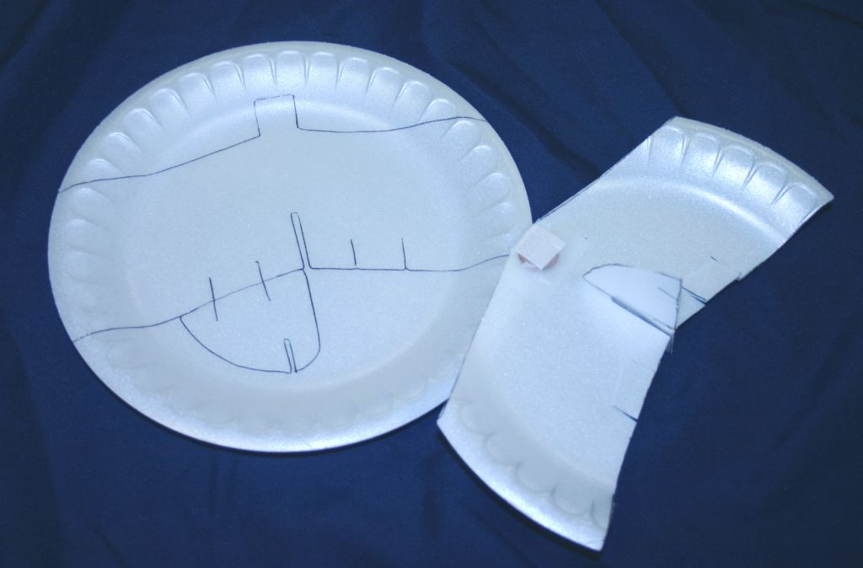
Cut out the paper template.
Trace the template of the FPG9 on a 9” Foam Plate
Like the plate above on the left.
* If you were supplied with a pre cut glider proceed to step 3.

Slide 14
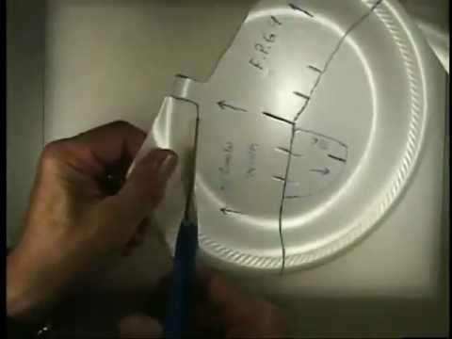
3. Carefully cut out your traced glider, cutting around the “tail”- triangular piece behind the left wing.
Front or Nose
Left wing
Right wing
Tail

Slide 15
* Note: the “Tail” is technically called the “Vertical Stabilizer” and is where the Rudder (moveable control) is. It is easier to say and type “Tail” for our assembly instructions.
Notes:
Make sure parts are labeled and team name is on glider now, easier to write on the foam before it is assembled and taped.

Slide 16
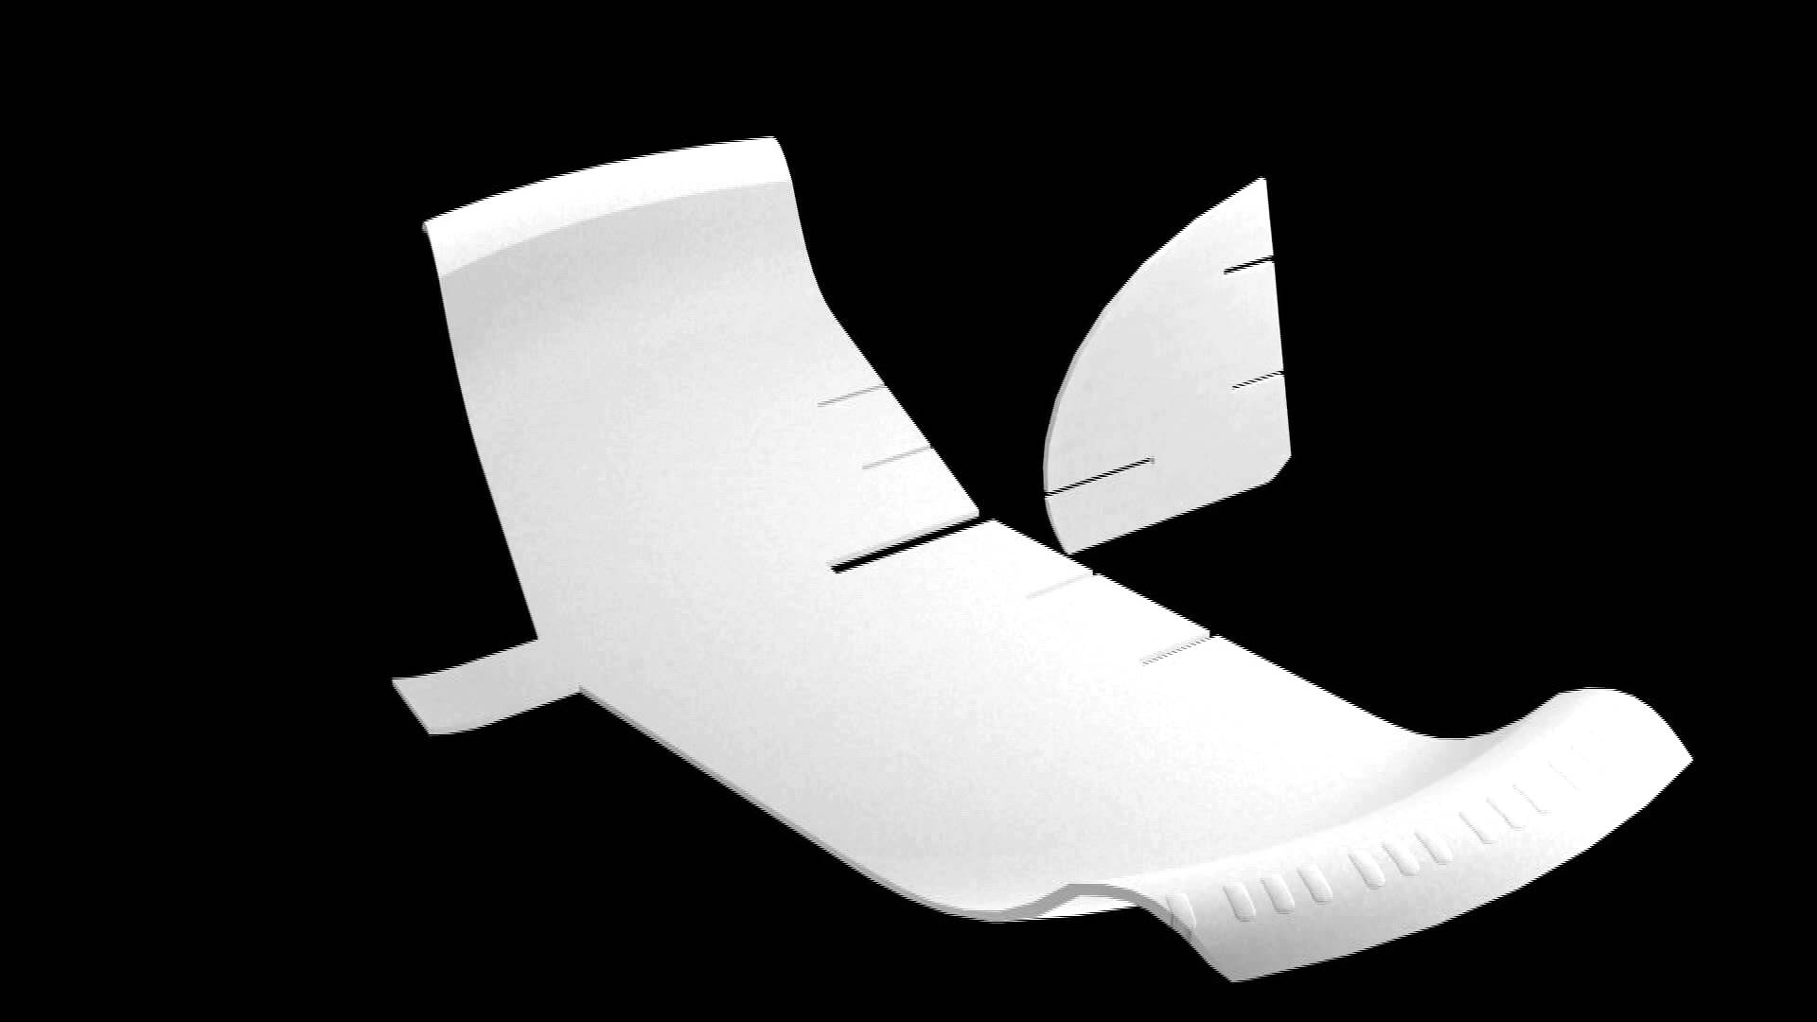
4. Carefully cut along the red line (below) separating
the “Tail” from the “Left Wing”
R
FPG9
E
E
AMA
_ _ _ _ _ _ _
You should have two pieces now that look like this.
R- Rudder E- Elevon
* Great time to label your control surfaces and add TEAM NAME to FPG9

Slide 17
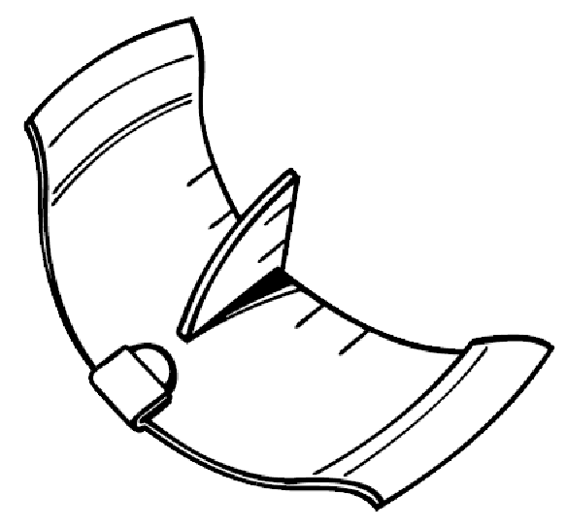
5. Cut “Slots” and “Slits”. Make sure the “Slots” are wide enough (about 2mm or the width of your scissor blade). Make sure “Slits” are cut so controls move. *DO NOT Cut the control surfaces out, the line lightly drawn between the “slits” is the “Hinge Line” that controls pivot on.
6. Join “Tail” to Wing. The “Tail” “Slot” should slide into the Wing “Slot” so that the “Tail” can be positioned at a 90 degree or Right angle to the wing with no binding. *This is an important detail! “ATD”
“Slits”
“SLOTS”

Slide 18
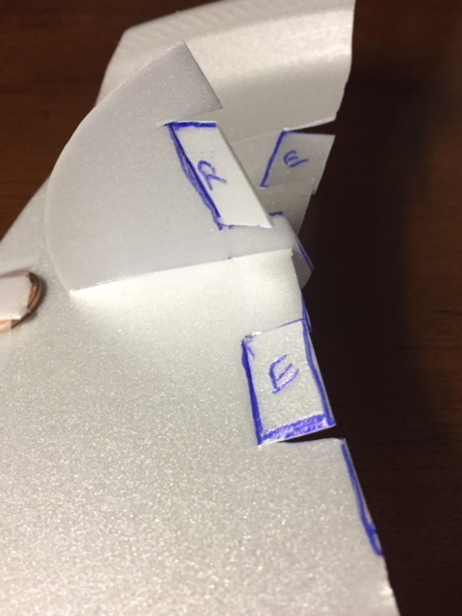
Time for an “ATD” Check!
(A great job for your “QA”- Quality Assurance people or person).
Have we:
> Labelled our control surfaces- R- Rudder E- Elevon?
*Note: Elevons combine an Elevator (pitch) and Aileron (roll)
> Lightly drawn lines for hinges (blue lines in photo below)?
> Cut the “Slits” to allow controls to move?
> Made sure our “Slots” allow the tail to be at a
right angle with no binding?
YES? Good, let’s finish…
Hinge
Slots
Hinge
slits
Notes:
Short discussion on “Center of Gravity” Flight demonstration with a glider with no penny makes great visual aid.

Slide 19
Almost done! Great job so far.
7. Time to tape the “Tail” onto the Wing, Using small pieces of tape secure top and bottom of tail while keeping the right angle.
8. Tape the penny under the flap
On the nose (front) of glider.
So what’s with the penny? Why do we add that?
“C” if you are “G”ood enough to figure it out?
C----- of G------
* Tape top and bottom of “Tail”
Tape
Tape
Tape
Notes:
When glider is assembled direct the teams NOT to fly yet. Have QA person check for team name and completion. Bring them forward for “inspection”. Keep the gliders out of reach until the learning objectives are complete and flying begins.

Slide 20
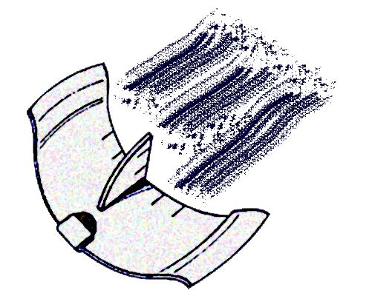
Almost time to fly. No flying until we are ready please!
We have a little more to do first.
Team Captains: Make sure your TEAM NAME is on your glider then bring it forward to the presenter for inspection please.

Slide 21
This is a “STEAM”- science Technology engineering Arts & Math presentation so…
Let’s talk a little Science
Just a little !
Notes:
This is intended as an introduction at the 4-6th level. Adjust discussion based on knowledge base. “Principles of Flight” interactive activity helps reinforce introduction.

Slide 22
Newton’s First Law of Motion- Inertia- “An object at rest stays at rest and an object in motion stays in motion with the same speed and in the same direction unless acted upon by an unbalanced force.”
For Airplanes- Let’s think about a “TRIMMED” (balanced) condition.
Newton’s Second Law of Motion- Force F=MA “Defines a force (F) to be equal to the product of the mass (M) of an object and its acceleration (A).”
For Airplanes let’s think about a “TAKEOFF”.
Newton’s Third Law of Motion- Push/ Pull “For every force exerted on or by an object, there is an equal and opposite reaction force.”
For Airplanes- Let’s think about “LIFT”.
Ok, I said a little. Let’s move on…
Notes:
“Principles of Flight” hyperlinked to AMA Flight School interactive activity.

Slide 23
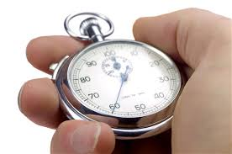
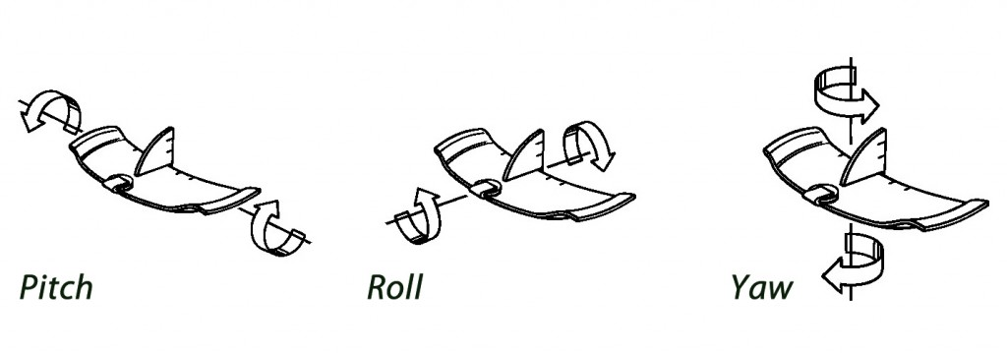
Quick Quiz about Aircraft Total Control from the movie.
For our FPG-9 Glider, what control surfaces do we use to control Pitch, Roll and Yaw?
Tic Toc Tic Toc…
Notes:
Should be a quick review, test recall on “elevon” vs Elevator and Aileron, traditional aircraft design. Use “demo” models if available.

Slide 24
Did you remember?
Elevons
Elevons
Why? Remember what
Elevons combine?
Rudder
Notes:
Short discussion/ mention of Engineering/ Design process.

Slide 25
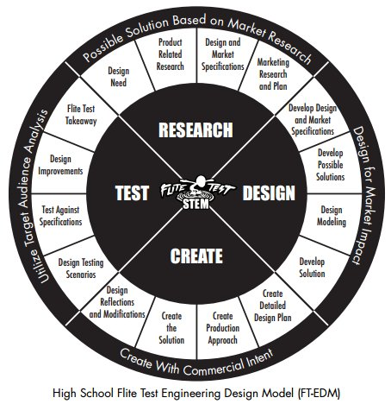
GREAT JOB!
WE DISCUSSED: SCIENCE TECHNOLOGY ENGINEERING ARTS & MATH
TOGETHER WE PERFORMED RESEARCH, STUDIED DESIGNS AND YOU CREATED A MODEL.
NOW IT’S TIME FOR THE IMPORTANT STEP OF TESTING YOUR MODELS. BEFORE WE DO I WANT TO SHARE A STORY ABOUT SOME OTHER STEM STUDENTS INVOLVED IN MODELING.
Notes:
Use Flight Test STEM student designers as inspiration point. If presenter has any Flight Test Alpha Bravo and/ or Charlie models it’s a great time for a closer look. If time permits and there is adequate space a flight demo in the school yard is a nice finishing touch after their glider competition.

Slide 26
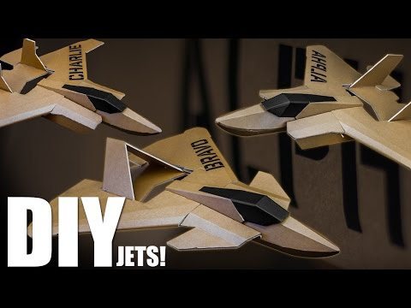
STEM AT WORK!
“FLITE TEST”ALPHA BRAVO AND CHARLIE RADIO CONTROL Do It Yourself “Jets”
The Challenge: Design a low cost, interchangeable
3- MODEL RC plane system in 1month.
This STEM team from Arizona did it in 3 weeks!
WHAT GRADE WERE THEY IN?

Slide 27
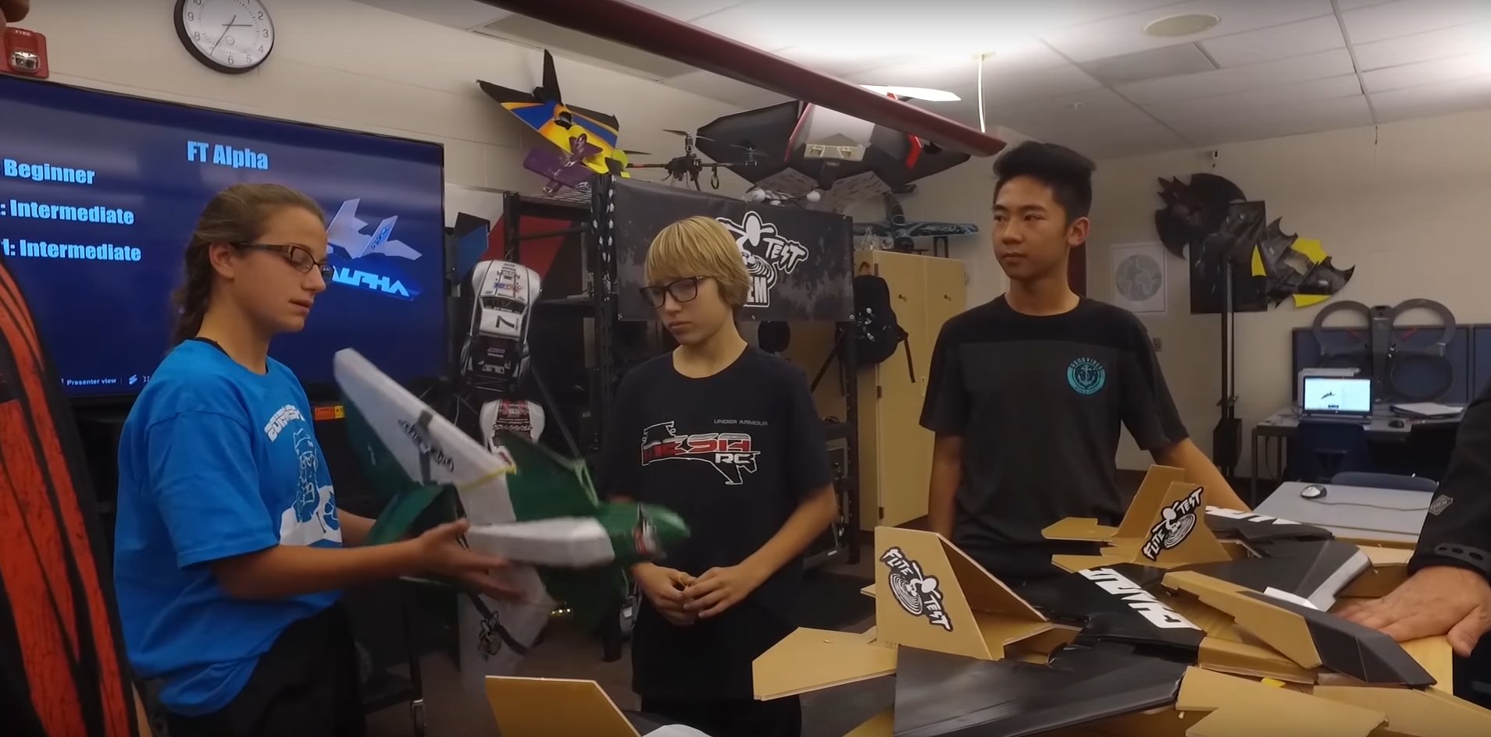
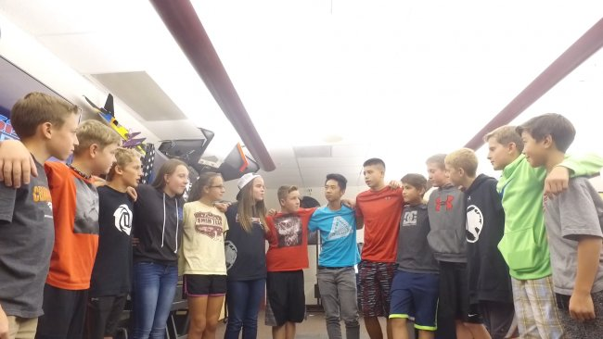
WOULD YOU BELIEVE 6, 7 AND 8TH GRADE?
PRETTY AWESOME

Slide 28
USE YOUR
IMMAGINATION, BUILD AND DREAM
BECAUSE DREAMS
CAN TURN THIS:

Slide 29
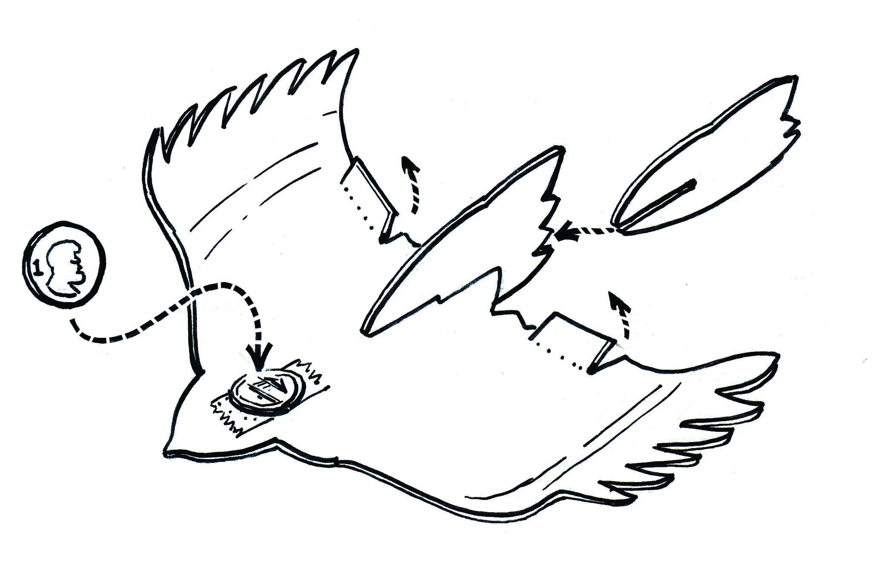
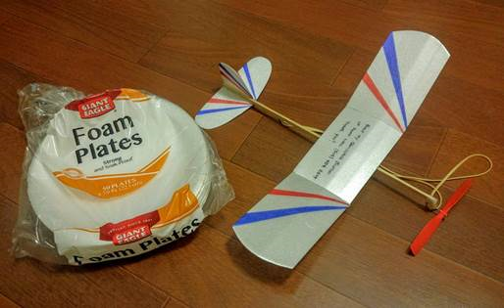
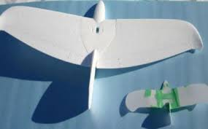
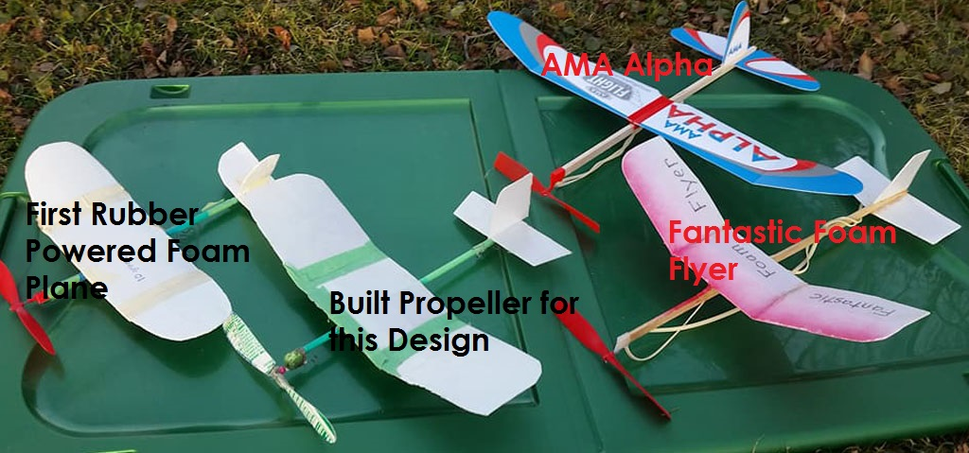
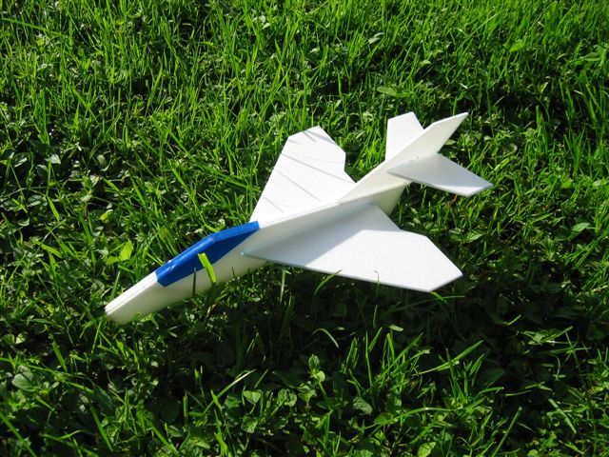
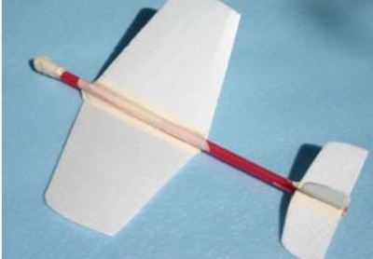
INTO THESE! All these models were created with foam, balsa wood and simple supplies. The other important ingredients in this formula for flying machines…
IMMAGINATION and INSPIRATION!

Slide 30
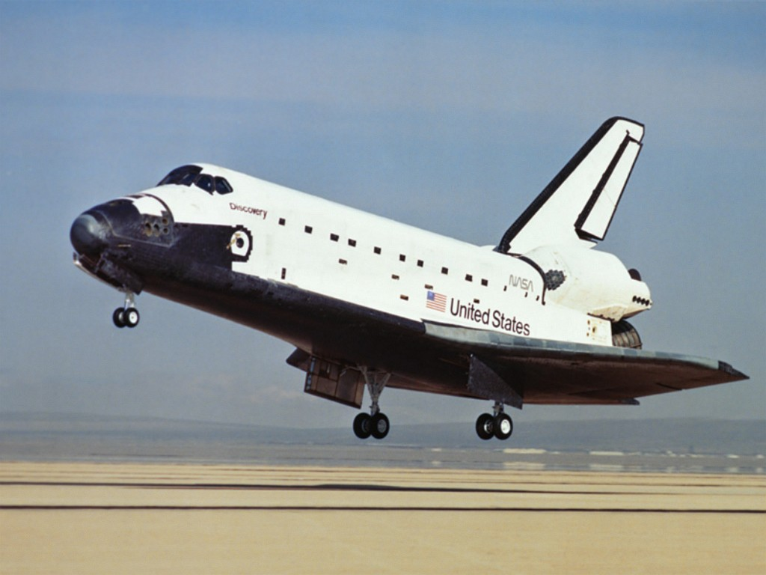
OR INTO THIS!
Notes:
Get teams lined up for flying test flights and competition. In an orderly, efficient manner have everyone get a test toss. Each team member will get a target- hula hoop held by presenter or volunteer at different positions encouraging team collaboration to calculate changing control inputs similar to FPG 9 simulator. Track team score on score sheet. Winning team members get a rubber balsa glider (or similar gift).
All departing students get: brochure pack (AMA flyers and club welcome to come fly), FPG 9 template and a plate.

Slide 31
Awesome job!
Thank You- Imagine, Build, Fly!

